Slide 1
EIS, MIS and Digital Dashboards

Slide 2
Executive Information System / Executive Support System
An Executive Information System can be defined as a specialized Decision Support System.
This type of the system generally includes the various hardware, software, data, procedures and the people. With the help of all this, the top level executives get a great support in taking and performing the various types of the decisions
. The executive information system plays a very important role in obtaining the data from the different sources, then help in the integration and the aggregation of this data. After performing these steps the resulting information is displayed in such a pattern that is very easy to understand.

Slide 3
INTRODUCTION
Executive information system is ‘a computer based system that serves the information that is needed by the various top executives. It provides very rapid access to the timely information and also offers the direct access to the different management reports.’
Executive Information System is very user friendly in the nature. It is supported at a large extent by the graphics.
Executive support system can be defined as the comprehensive executive support system that goes beyond the Executive Information System and also includes communications, office automation, analysis support etc.

Slide 4
Factors Affecting Need of EIS
According to Watson, Executive Information System / executive support system depends on some of the factors that can be summarized as the follows
1. Internal factors i. Need for the timely information. ii. Need for the improved communications. iii. Need for the access to the operational data. iv. Need for the rapid status updates on the various business activities. v. Need for the access to the corporate database. vi. Need for very accurate information. vii. Need for the ability to identify the various historical trends.

Slide 5
2. External Factors i. Increasing and intensifying the global competition. ii. Rapidly changing the business environment. iii. Need to be more pro active. iv. Need to access the external database. v. Increasing the various government regulations.

Slide 6
Characteristics of the Executive support system/ Executive Information System
1. Informational characteristics i. Flexibility and ease of use. ii. Provides the timely information with the short response time and also with the quick retrieval. iii. Produces the correct information. iv. Produces the relevant information. v. Produces the validated information

Slide 7
2. User interface/orientation characteristics i. Consists of the sophisticated self help. ii. Contains the user friendly interfaces consisting of the graphic user. iii. Can be used from many places. iv. Offers secure reliable, confidential access along with the access procedure. v. Is very much customized. vi. Suites the management style of the individual executives.
3. Managerial / executive characteristics i. Supports the over all vision, mission and the strategy. ii. Provides the support for the strategic management. iii. Sometimes helps to deal with the situations that have a high degree of risk. iv. Is linked to the value added business processes. v. Supports the need/ access for/ to the external data/ databases. vi. Is very much result oriented in the nature.

Slide 8
Executive Information System / Executive Support System capabilities
1. Helps in accessing the aggregated or macro or global information. 2. Provides the user with an option to use the external data extensively. 3. Enables analysis of the address and the hoc queries. 4. Shows the trends, the ratios and the various deviations. 5. Helps in incorporating the graphic and the text in the same display, which helps to have a better view. 6. It helps in the assessment of the historical as also the latest data. 7. Problem indicators can be highlighted with the help of the Executive Information System / executive support system. 8. Open ended problem explanation with the written interpretations can be done with the help of the Executive Information System / executive support system. 9. Offers management by the exception reports. 10. Utilizes the hyper text and the hyper media. 11. Offers generalized computing. 12. Offers telecommunications capacity.

Slide 9
Executive Information System / Executive Support System benefits
1. Achievement of the various organizational objectives. 2. Facilitates access to the information by integrating many sources of the data. 3. Facilitates broad, aggregated perspective and the context. 4. Offers broad highly aggregated information. 5. User’s productivity is also improved to a large extent. 6. Communication capability and the quality are increased. 7. Provides with the better strategic planning and the control. 8. Facilitates pro active rather than a reactive response. 9. Provides the competitive advantage. 10. Encourages the development of a more open and active information culture. 11. The cause of a particular problem can be founded.

Slide 10
MIS
Simply MIS stand For Management Information System. For Simply Understanding Management Information System (MIS) we can divide in to three Word and Understand Part by part
Management: - “Management is function to do the work at the Right time, by the right Person, For the Right Job.”
Information: - “Information is the Collection of Organized data which plays a Vital Role for decision making.”
System:-“System Consist for a set of elements which Provides a Framework to convert Unorganized (Data) into Organized Information.”

Slide 11
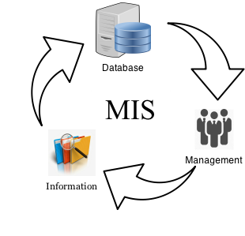
Meaning of Management Information System
Management information system refers to such system which provides accurate information to the entire level of management for decision making process. For right job at the right time, by the right person.

Slide 12
Role of Management Information System
Management information system (MIS) has become Very Necessary due to Emergence of high complexity in Business Organization. It is all to know that without information no Organization can take even one step properly regarding the decision making process. Because it is matter of fact that in an organization decision plays an essential role for the achievement of its objectives and we know that every decision is based upon information. If gathered information are irrelevant than decision will also incorrect and Organization may face big loss & lots of Difficulties in Surviving as well.
1) Helps in Decision making: - Management Information System (MIS) plays a significant Role in Decision making Process of any Organization. Because in Any organization decision is made on the basis of relevant Information and relevant information can only be Retrieving from the MSI.

Slide 13
2) Helps in Coordination among the Department: - Management information System is also help in establishing a sound Relationship among the every persons of department to department through proper exchanging of Information’s.
3) Helps in Finding out Problems: - As we know that MIS provides relevant information about the every aspect of activities. Hence, If any mistake is made by the management then Management Information Systems (MIS) Information helps in Finding out the Solution of that Problem.
4) Helps in Comparison of Business Performance: - MIS store all Past Data and information in its Database. That why management information system is very useful to compare Business organization Performance. With the help of Management information system (MIS) Organization can analyze his Performance means whatever they do last year or Previous Years and whatever business performance in this year and also measures organization Development and Growth.

Slide 14
Components of MIS and their relationship
A management information system is made up of five major components namely people, business processes, data, hardware, and software. All of these components must work together to achieve business objects.
People – these are the users who use the information system to record the day to day business transactions. The users are usually qualified professionals such as accountants, human resource managers, etc. The ICT department usually has the support staff who ensure that the system is running properly.
Business Procedures – these are agreed upon best practices that guide the users and all other components on how to work efficiently. Business procedures are developed by the people i.e. users, consultants, etc.
Data – the recorded day to day business transactions. For a bank, data is collected from activities such as deposits, withdrawals, etc.

Slide 15
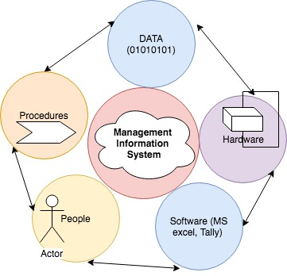
4. Hardware – hardware is made up of the computers, printers, networking devices, etc. The hardware provides the computing power for processing data. It also provides networking and printing capabilities. The hardware speeds up the processing of data into information.
5. Software – these are programs that run on the hardware. The software is broken down into two major categories namely system software and applications software. System software refers to the operating system i.e. Windows, Mac OS, and Ubuntu, etc. Applications software refers to specialized software for accomplishing business tasks such as a Payroll program, banking system, point of sale system, etc.

Slide 16
Advantages of MIS and reporting
1. Helps in managing data: MIS helps in maintaining and managing crucial business data for assisting in complex decision-making by the management. The critical information is stored in an organized manner, and it can be accessed by the administration quickly whenever required.
2. Analyses trends: Management needs to prepare forecasts for strategic planning and determine future goals. Thus, to create such a strategy, it is essential to have accurate reports on prevailing market trends. MIS uses various mathematical tools for analyzing the current market trend and predicting future trends based on such information.
3. Helps in strategic planning: MIS reports play a significant role in the strategic planning of the company. It helps in determining the future needs of the company and assists in formulating goals and strategy based on such information. Management information system report is also helpful in identifying resources required to meet the company’s objective. Thus, it is vital that the information provided by MIS and reporting is accurate and reliable.
4. Goal Setting: For any organization, setting up a goal is very crucial matter, and it requires lots of research and development. Since the information provided in MIS reports is based on current data analysis, hence it is considered suitable and material for determining the goal of an enterprise. Also, MIS reporting includes the current market trend analysis and prediction of the future trend. Thus, it is quite difficult for any company to neglect MIS and reporting.

Slide 17
5. Problems identification: MIS report provides information related to every aspect of activities taking place in the company. Hence, in case any problem arises in front of the management, MIS reports are quite helpful in identifying the source of the problem. Also, MIS and reporting are really useful in finding the solution to such an issue.
6. Increases efficiency: The relevant information provided by MIS and reporting is utilized in formulating goals and strategy of the company. Also, the performance of the business can be assessed with the help of MIS reports. Hence, MIS plays a vital role in increasing the efficiency of the company.
7. Comparison of Business Performance: The relevant business data and information of the company is stored and maintained in the MIS database. Since the MIS database can be accessed at any time; hence, the current performance of the firm can be compared with its previous year’s achievement to measure the organization’s growth.

Slide 18
Types of reports that can be produced using an MIS?
– Summary reports: As the name suggests, summary reports summarise data and present it in a consolidated format. They aggregate data from several categories like accounting periods, product categories etc and present it in a format that managers can review and analyze conveniently. Some of the most common summary reports are sales summary reports, inventory reports etc. An inventory summary reports can present information on inventory in stock, its total value and the recent purchases. A sales summary report will present sales data grouped under different categories like product categories and geographic regions.
– Trend reports: The trend reports make it easier for the managers to understand trends. For example you would like to compare the sales trends in America versus that in Asia for a specific product. You can learn about the performance of specific business units and product categories over a given time period. Such reports can be used to analyse historical trends and identify grey areas that require special focus. For example, if sales of a specific product has kept falling in China, the management may need to define a new sales or marketing strategy or might need to release a new product there. Trends are important to study since if a particular product has not been performing well in a certain market over a given time period, then you cannot expect it to start performing well in future. The management may need to make alterations to its strategy to increase sales or it may just discontinue the product. Trend reports also help brands remain competitive and perform well in the market by understanding trends and using the information to predict sales and formulae the right sales strategy.

Slide 19
– Exception Reports:
As the name suggests exceptions reports are based on data that does not fall within normal ranges. Exception reports focus on this unusual data and present it separately so managers can pay immediate attention to such exceptions. Rather than having to go through each report, the managers get to review all such unusual conditions at one place in a single report. For example, one can set an exception for low stock and that will help the store manager notice which products’ stocks are running low and need to be ordered immediately. Such exception reports also prove useful in the areas of HR and finance.
On demand reports:
The on demand reports are reports specific to the demand of the situation and the manager. Such reports can be presented in the form of a customised report or in one of the summary or trend report format. For example, a business manager would like to know which products are most popular during the holiday season. He would also want to know which products are more popular in UK and which ones in Australia. A marketing manager can use these reports to know which products would need to be advertised more often and if a change in promotion or pricing strategy can affect their sales.

Slide 20
MIS Uses for Small Businesses:
Even small businesses stand to benefit from the use of MIS. Whether it is a doctor’s office or a small retailer, MIS can be used for planning as well as for perfect allocation of the limited resources at your dispense. If small businesses can install MIS software, it will help them keep track of business performance and based upon this information, they can make better use of their human and financial resources. Even the small businesses face heavy competition and their survival also depends on careful planning as well as proper control and management. Some of the main benefits that come from the utilisation of MIS in case of small businesses are as follows:

Slide 21
– Internal processes have to be formulated and established based upon MIS reports which will help at better utilisation of the limited human and financial resources. This helps manage the organisational productivity and performance of the human capital better.
– Small businesses too need specific, demand based and effective information to remain competitive and this purpose can be served using an MIS.
– Efficient control of personnel and operations.
– Efficient office management and reduction in operational costs.
– Predict future trends and take action before competing businesses.
An MIS does not mean extra expenses for a small business. Instead it will help you overcome performance bottlenecks and derive better results from the resources at your dispense. For example, if a doctor can keep an MIS, it will help him manage patient’s personal data better and will help him link it with insurance and billing companies easily. A retailer can keep track of inventory in stock and manage it better. Moreover, there are not any major costs involved in keeping an MIS apart from the cost of hardware and software and some basic skills. In several cases, it will only help a small business fill major performance gaps and bring operational costs lower.

Slide 22

What is a Digital Dashboard?
A Digital Dashboard is an electronic interface that aggregates and visualizes data from multiple sources, such as databases, locally hosted files, and web services. Dashboards allow you to monitor your business performance by displaying historical trends, actionable data, and real-time information.

Slide 23
Digital dashboard definition
Digital dashboard: an information management tool that is used to track KPIs, metrics, and other key data points relevant to a business, department, or specific process. Through the use of data visualizations, dashboards simplify complex data sets to provide users with at a glance awareness of current performance.
A digital dashboard is an electronic interface used to acquire and consolidate data across an organization. A digital dashboard provides in-depth business analysis, while providing a real-time snapshot of department productivity, trends and activities and key performance indicators, etc.
A digital dashboard is also known as a dashboard, traffic dashboard and traffic dash.

Slide 24
How does digital dashboard software work?
Everyone in the business, regardless of their role, has questions about how your company is performing. How is our campaign performing on social media? What is our churn rate today? How many customers are waiting on a reply from our sales reps? Digital dashboards and compelling data visualizations allow you to answer these quickly.

Slide 25
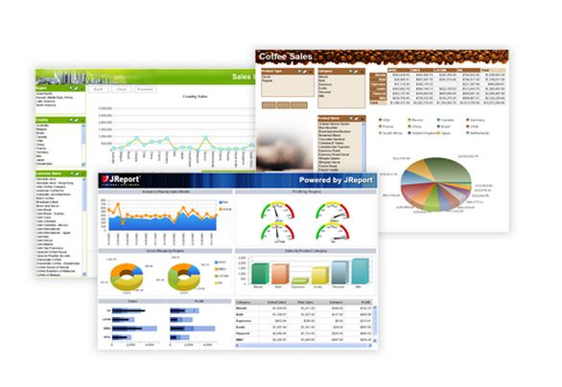

Slide 26
Benefits
Digital dashboards allow managers to monitor the contribution of the various departments in their organization. To gauge exactly how well an organization is performing overall, digital dashboards allow you to capture and report specific data points from each department within the organization, thus providing a "snapshot" of performance.
Benefits of using digital dashboards include:
Visual presentation of performance measures
Ability to identify and correct negative trends
Measure efficiencies/inefficiencies
Ability to generate detailed reports showing new trends
Ability to make more informed decisions based on collected business intelligence
Align strategies and organizational goals
Saves time compared to running multiple reports
Gain total visibility of all systems instantly
Quick identification of data outliers and correlations

Slide 27
Types of digital dashboards
Analytical Dashboards
Analytical dashboards focus on accumulating insights for data over time – often the past month or quarter. These insights are then used to understand what happened, why it happened, and what changes can and should be made to positively affect these in the future. Analytical dashboards primarily use what-if analysis and pivots to identify patterns and opportunities, and help align business goals with performance management initiatives. For example, let’s say that an organization wants to compare trends over time or identify why certain products are performing better in one region than another, that organization would build and refer to a digital analytics dashboard. Similarly, and company wanting to examine the success of marketing campaigns by combining sales data with product placement and marketing campaign strategy to determine the success of individual campaigns and areas for improvement would do the same. In short, analytical dashboards are meant to help an organization establish targets based on insights into historical data.

Slide 28
Operational Dashboards
Operational dashboards focus on managing day-to-day business processes, giving continual view into what is happening within the business unit – frequently changing and current performance metrics or key performance indicators (KPIs). While these types of dashboards are most common in business environments where it is critical to act on any opportunities and issues as quickly as possible (sales, marketing, help-desk, supply-chain, etc.), operational dashboards are applicable in almost every department and are often used organization wide. Similar to analytical dashboards, these dashboards can also help to identify recurring trends over time and provide context around KPIs, the visibility they provide into current, actionable data separates them from a solely analytics-based dashboard. In short, operational dashboards are meant to help an organization understand if it’s performance is on or off target, and by how much, in real time.
Strategic / Executive Dashboards
Strategic or executive dashboards focus on providing the KPIs that business executives need to monitor on a daily, weekly, or monthly basis. These dashboards should display high-level summaries of the most important and relevant data on the overall progress of the business, as well as where realistic goals may be set in the future.

Slide 29
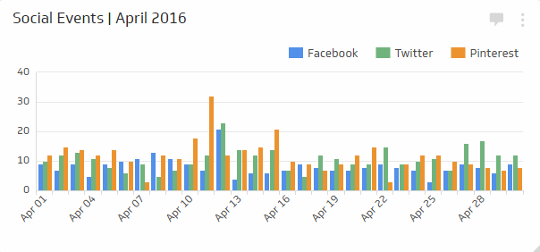
Examples of metrics and KPIs used on dashboards
Social Events - Monitors key events on each of your social channels such as likes, reposts, and mentions, and assigns them a weight according to their significance. Learn more about metrics for your businesses social media dashboard.

Slide 30
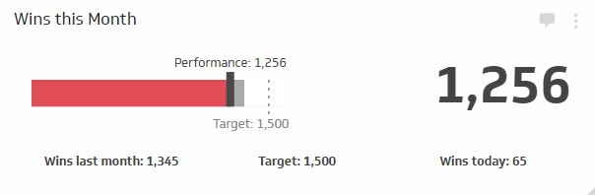
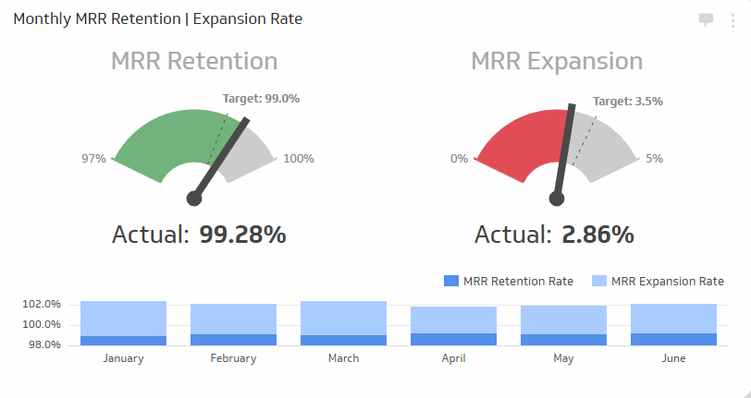
Sales Target - Measures the number of wins over a specific time period and compares it to a target value and past performance to motivate your sales team.
Customer Retention Rate - Measures the rate at which a subscription based company holds on to its customers. The compliment of 'Retention Rate' is 'Attrition' or 'Churn Rate’.

Slide 31
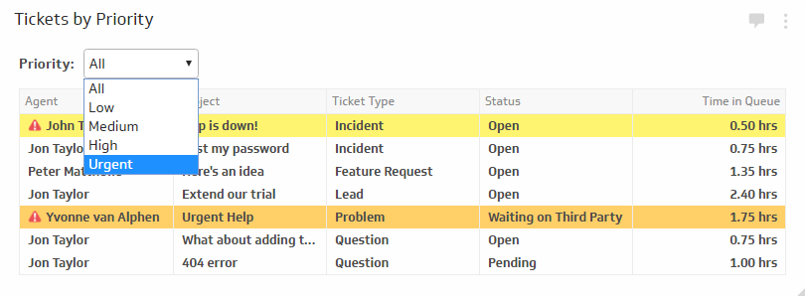
Ticket Queue - Analyzes tickets in queue to prioritize urgent issues, and coordinates a response that will resolve customer issues in a timely manner

Slide 32
Decision support systems (DSS)
Decision support systems (DSS) are interactive software-based systems intended to help managers in decision-making by accessing large volumes of information generated from various related information systems involved in organizational business processes, such as office automation system, transaction processing system, etc.
DSS uses the summary information, exceptions, patterns, and trends using the analytical models. A decision support system helps in decision-making but does not necessarily give a decision itself. The decision makers compile useful information from raw data, documents, personal knowledge, and/or business models to identify and solve problems and make decisions.

Slide 33
Programmed and Non-programmed Decisions
There are two types of decisions - programmed and non-programmed decisions.
Programmed decisions are basically automated processes, general routine work, where −
These decisions have been taken several times.
These decisions follow some guidelines or rules.
For example, selecting a reorder level for inventories, is a programmed decision.
Non-programmed decisions occur in unusual and non-addressed situations, so −
It would be a new decision.
There will not be any rules to follow.
These decisions are made based on the available information.
These decisions are based on the manger's discretion, instinct, perception and judgment.
For example, investing in a new technology is a non-programmed decision.
Decision support systems generally involve non-programmed decisions. Therefore, there will be no exact report, content, or format for these systems. Reports are generated on the fly.

Slide 34
Attributes of a DSS
Adaptability and flexibility
High level of Interactivity
Ease of use
Efficiency and effectiveness
Complete control by decision-makers
Ease of development
Extendibility
Support for modeling and analysis
Support for data access
Standalone, integrated, and Web-based

Slide 35
Characteristics of a DSS
Support for decision-makers in semi-structured and unstructured problems.
Support for managers at various managerial levels, ranging from top executive to line managers.
Support for individuals and groups. Less structured problems often requires the involvement of several individuals from different departments and organization level.
Support for interdependent or sequential decisions.
Support for intelligence, design, choice, and implementation.
Support for variety of decision processes and styles.
DSSs are adaptive over time.

Slide 36
Benefits of DSS
Improves efficiency and speed of decision-making activities.
Increases the control, competitiveness and capability of futuristic decision-making of the organization.
Facilitates interpersonal communication.
Encourages learning or training.
Since it is mostly used in non-programmed decisions, it reveals new approaches and sets up new evidences for an unusual decision.
Helps automate managerial processes.

Slide 37
Components of a DSS
Following are the components of the Decision Support System −
Database Management System (DBMS) − To solve a problem the necessary data may come from internal or external database. In an organization, internal data are generated by a system such as TPS and MIS. External data come from a variety of sources such as newspapers, online data services, databases (financial, marketing, human resources).
Model Management System − It stores and accesses models that managers use to make decisions. Such models are used for designing manufacturing facility, analyzing the financial health of an organization, forecasting demand of a product or service, etc.
Support Tools − Support tools like online help; pulls down menus, user interfaces, graphical analysis, error correction mechanism, facilitates the user interactions with the system.

Slide 38
Classification of DSS
There are several ways to classify DSS. Hoi Apple and Whinstone classifies DSS as follows
Text Oriented DSS − It contains textually represented information that could have a bearing on decision. It allows documents to be electronically created, revised and viewed as needed.
Database Oriented DSS − Database plays a major role here; it contains organized and highly structured data.
Spreadsheet Oriented DSS − It contains information in spread sheets that allows create, view, modify procedural knowledge and also instructs the system to execute self-contained instructions. The most popular tool is Excel and Lotus 1-2-3.
Solver Oriented DSS − It is based on a solver, which is an algorithm or procedure written for performing certain calculations and particular program type.
Rules Oriented DSS − It follows certain procedures adopted as rules.
Rules Oriented DSS − Procedures are adopted in rules oriented DSS. Export system is the example.
Compound DSS − It is built by using two or more of the five structures explained above.

Slide 39
Types of DSS
Following are some typical DSSs −
Status Inquiry System − It helps in taking operational, management level, or middle level management decisions, for example daily schedules of jobs to machines or machines to operators.
Data Analysis System − It needs comparative analysis and makes use of formula or an algorithm, for example cash flow analysis, inventory analysis etc.
Information Analysis System − In this system data is analyzed and the information report is generated. For example, sales analysis, accounts receivable systems, market analysis etc.
Accounting System − It keeps track of accounting and finance related information, for example, final account, accounts receivables, accounts payables, etc. that keep track of the major aspects of the business.
Model Based System − Simulation models or optimization models used for decision-making are used infrequently and creates general guidelines for operation or management.

